Slide 1


Sentiment Analysis of social media for airline customer service improvement
Team members: Sujith Chandra dara – a20528384
Bhargava ramani gorle – a20528476
Presented on April 5th 2024

Slide 2
Introduction to Sentiment Analysis
Understanding Public Sentiment: Sentiment analysis provides insights into customer perceptions, crucial for improving services and customer satisfaction in sectors like the airline industry.
01
Project Objective: Our goal is to use machine learning to classify airline-related tweets into sentiments (positive, neutral, negative), helping airlines to enhance service quality.
02
Natural Language Challenges: Analyzing tweets involves navigating sarcasm, informal language, and mixed emotions, requiring advanced analytical techniques to accurately interpret sentiment.
03

Slide 3
Project workflow
Dataset Selection
Data Preprocessing
Model Selection
Training and Development
Evaluation
Deployment

Slide 4
Data Description
Dataset Composition: The dataset comprises 14,640 tweets aimed at various airlines, labeled with sentiments. It reflects a wide range of customer feedback.
Crucial Attributes: We focus on attributes like tweet_id, airline_sentiment, text, and retweet_count, which are key to understanding and classifying sentiments.
Diverse Interactions: The dataset encapsulates a broad spectrum of customer interactions, from complaints to compliments, offering a comprehensive base for analysis.

Slide 5
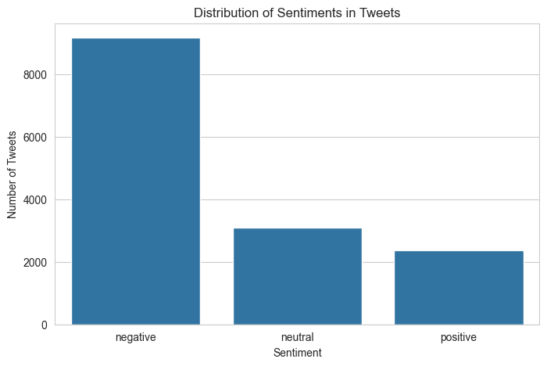
Sentiment Distribution in Tweets
Prevalence of Negative Sentiments: The dataset contains a notably higher number of negative sentiment tweets, indicative of users being more inclined to share unfavorable experiences or issues requiring attention.
Balanced Sentiment Representation: Neutral and positive sentiments are less represented, which may require resampling methods in model training to prevent bias towards negative sentiments.
Data Collection Bias: The imbalance also suggests a potential bias in data collection, which should be accounted for in analysis and modeling to avoid skewing results.

Slide 6
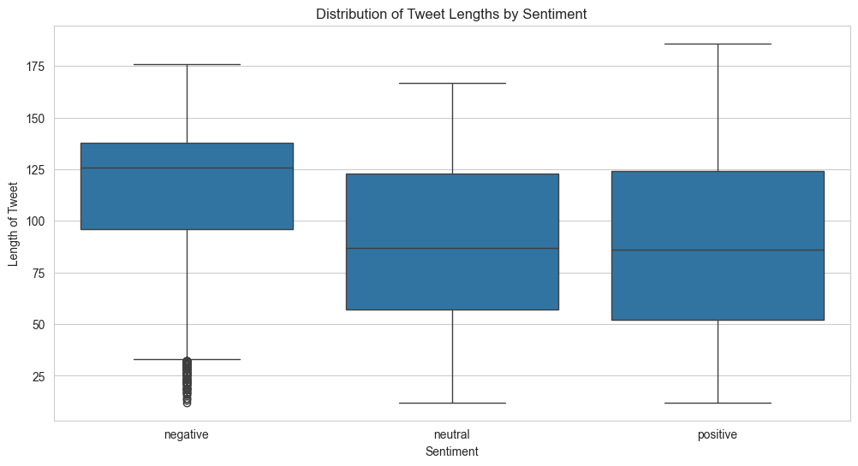
Tweet Length Distribution by Sentiment
Consistency Across Sentiments: The distribution of tweet lengths is relatively consistent across different sentiments, with median lengths centered around the same value for all categories.
Negative Sentiments and Length: Negative tweets have a slightly wider range of lengths, suggesting that users may be providing more detailed feedback when expressing dissatisfaction.
Length as a Feature: Given the similarities in distributions, tweet length might not be a strong standalone feature for sentiment classification but could contribute to a more nuanced feature set in combination with other text attributes.

Slide 7
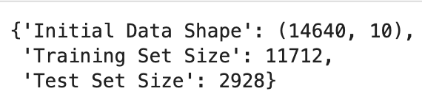
Data Preprocessing Steps
Cleaning and Standardizing: Removed irrelevant characters (e.g., symbols, numbers) from tweets and standardized text case to reduce data noise and improve consistency. Removing the unwanted columns which we not essential for our analysis.
Vectorizing Text: Applied TF-IDF vectorization to transform tweet texts into numerical data, emphasizing words significant to sentiment, and facilitating machine learning model input.
Feature Selection: Select relevant features for sentiment analysis, considering factors such as tweet text, user sentiment, and metadata attributes that contribute to the sentiment classification task.
Splitting the Dataset: Divide the dataset into training and test sets to evaluate model performance accurately. Typically, a random split is used, with a portion of the data allocated for training the model and the remainder for evaluating its performance.
Missing Values Management: Employed imputation for missing numerical data and used "None" or similar placeholders for categorical fields with missing information, ensuring completeness without skewing analysis.

Slide 8
Advanced Preprocessing Techniques
Normalization Nuances: We converted all text to lowercase and removed punctuation to standardize the dataset, which helps in reducing the complexity of the language model.
Twitter Text Specifics: Special Twitter entities like mentions (@usernames) and hashtags (#topic) were parsed differently to preserve their unique communicative value.
Stop Words Removal: Commonly used words that do not contribute to sentiment were filtered out to focus on words with higher predictive power for sentiment analysis.

Slide 9
Model Selection Explained
Baseline Model – Logistic Regression: Chosen for its quick training times and interpretable nature, which provides a benchmark for evaluating more complex models.
SVM for Non-linear Patterns: SVMs are adept at finding the optimal boundary between classes, especially in high-dimensional spaces like text data.
LSTM for Sequential Data: LSTMs are designed to understand context in sequences, making them ideal for text where the order of words is significant.

Slide 10

Model Development and Training
Logistic Regression as Baseline: Chose logistic regression for its simplicity and interpretability, providing a solid baseline for comparison with more complex models.
Comprehensive Model Evaluation: Assessed accuracy to gauge overall performance, complemented by precision, recall, and F1 scores for detailed insight into classification success across sentiment categories.
Optimization via GridSearchCV: Utilized GridSearchCV to fine-tune logistic regression parameters (e.g., regularization strength, penalty type), aiming to enhance model prediction accuracy.

Slide 11
Strategies to Handle Data Imbalance
Model Bias Toward Majority Class: Models trained on imbalanced data often favor the majority class, resulting in poor predictive performance for the minority class.
Resampling Techniques: Implementing SMOTE to generate synthetic examples of the minority class, thereby balancing the dataset and reducing model bias.
Importance of Adjusted Metrics: Utilizing metrics like the F1-score or Matthews correlation coefficient that are better suited for evaluating performance on imbalanced datasets.

Slide 12
Challenges and Ethical Considerations
Complexities of Language Processing: Natural language processing (NLP) models face challenges in accurately interpreting nuances like sarcasm and idioms, leading to potential misclassification of sentiments.
Bias in Training Data: Data collected from social media can be biased towards more vocal users and may not represent the sentiment of the wider public, potentially skewing the model's predictions.
Transparency in Model Decisions: There's a need to ensure that the decisions made by sentiment analysis models are transparent and interpretable, allowing users to understand and trust the results.
Privacy Concerns: Sentiment analysis of social media data must be conducted with respect for user privacy, ensuring that data is used responsibly and ethically, particularly when dealing with sensitive information.

Slide 13
Achievements and Next Steps
Current Achievements: Successfully preprocessed the dataset, developed a logistic regression model achieving ~79.5% accuracy, and conducted initial optimization attempts.
Future Directions: Plan to explore SVM and LSTM models for potential performance improvements, undertake advanced feature engineering, and apply more sophisticated optimization techniques.
Project Goals: Finalize model comparisons, optimize performance, and produce a comprehensive analysis with actionable recommendations for utilizing sentiment analysis in airline service improvement.

Slide 14

Conclusion
Implications for Airlines: This project aims to equip airlines with data-driven insights into customer sentiment, fostering enhanced decision-making for service improvements.

